Slide 1

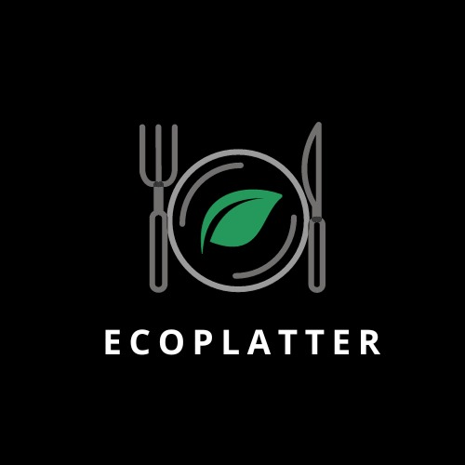
ECO-PLATTER
Harvesting Hope, One Meal at a Time.

Slide 2
01
02
TABLE OF CONTENTS
03
04
Problem Statement
Optimizing Food Waste Management System
Proposed Solution
Developing a food donation app
What is Ecoplatter?
A Food Donation App
How does our innovation accelerate change with the power of technology?
05
Output of our working model
06
Conclusion and Future scope

Slide 3
01
PROBLEM STATEMENT
Optimizing Food Waste Management System

Slide 4
Problem Statement: Optimizing Food Waste Management System
Food waste refers to the disposal or squandering of edible food at various stages of the food supply chain, from production and processing to distribution and consumption. It is a global problem with significant environmental, economic, and social consequences. Food waste management faces a set of distinct challenges that contribute to significant economic, environmental, and social issues. Some key problems associated with food waste include:
Loss of Resources: When food is wasted, the resources used in its production, such as water, energy, and agricultural inputs, are also lost.
High Levels of Food Waste: Enormous amounts of food are wasted at various stages of the supply chain, from production and processing to distribution and consumption.
Environmental Impact: Decomposing food waste in landfills produces methane, a potent greenhouse gas that contributes to climate change.
Economic Losses: Food waste represents a significant economic loss for producers, distributors, retailers, and consumers.
Limited Food Recovery Infrastructure: Some regions lack the infrastructure and facilities for effective food recovery and redistribution.

Slide 5
02
PROPOSED SOLUTION
Developing a food donation app

Slide 6
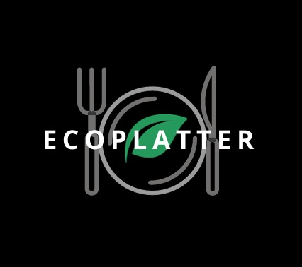
Proposed Solution: The primary objective of this project is to develop an app which links together Companies, Organizations and Individuals to facilitate the donation of surplus food.

Slide 7
03
WHAT IS ECOPLATTER?

Slide 8
What is Ecoplatter?
It is a prototype based model that makes direct connection between food donors and those in need of donation, this app was designed with the thought of providing delicious , decent quality and safe to consume food to those who are in serious need of it. Every year according to a 2012 consensus fast food or big chain restaurants throw away about 12 kilo tons of good quality edible food items . restaurants waste an average of 4-10% of all the inventory they purchase. And accordingly every year lakhs of homeless people and orphans die of starvation. An effective solution is to donate the food that was going to be passed on as wastage to these individuals hence solving hunger problems and wastage issues.

Slide 9
The project will encompass the following key components:
01
02
03
User Registration
Food Donation Listings
Food Request System
04
05
06
Location-Based Search
Messaging and Notifications
Food Safety Guidelines

Slide 10
04
How does our innovation accelerate change with the power of technology?

Slide 11
The development of this app accelerates change in such ways:
Reduced Food Waste:
The app directly addresses the issue of food waste by streamlining the process of matching surplus food with those in need.
Community Engagement:
01
Promotes collaboration and engagement between businesses, non-profits, and individuals, fostering a sense of community responsibility.
02
Environmental Impact:
By diverting surplus food from landfills, the app helps reduce greenhouse gas emissions and lowers the overall environmental impact of food waste.
03
Scalability:
The app's scalable model allows for expansion to new regions, encouraging a broader network of participants and maximizing the impact on food waste reduction
04

Slide 12
05
Output of our working model

Slide 13
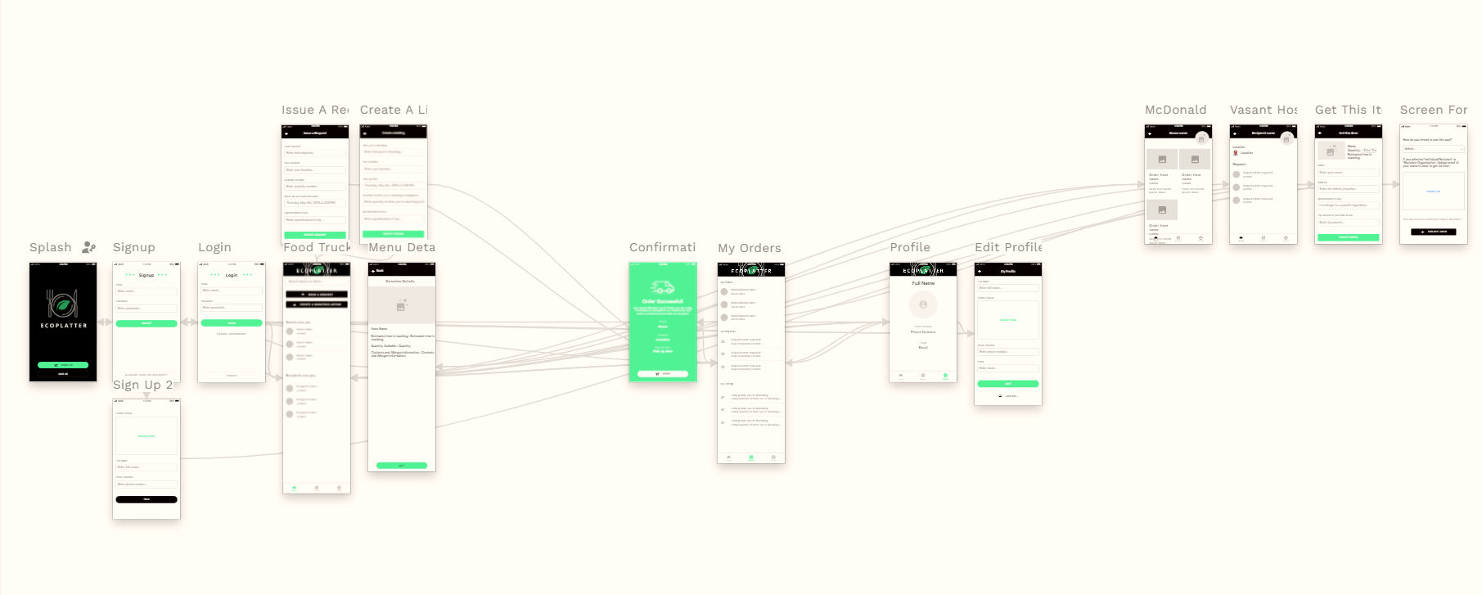
Output our working model
Prototype

Slide 14
05
CONCLUSION AND FUTURE SCOPE

Slide 15
CONCLUSION
The identified problem revolves around the optimization of waste management systems, with a focus on surplus food. The proposed solution entails the development of a comprehensive app that acts as a nexus, connecting companies, organizations, and individuals to streamline the donation of surplus food. Simultaneously, a sophisticated food request system enables charities, food banks, and individuals in need to seek specific food items, triggering notifications to potential donors.

Slide 16
Future Scope
The future scope of an app facilitating surplus food donation involves potential expansion, increased efficiency, and broader societal impact. This includes:
Global Scale, Financial Integration, Sustainability Metrics, Education and Awareness, Accessibility and Inclusivity

Slide 17
Contribution of the teammates
Pooja Ramdas
Prisha Vohra
Sharvari Godbole
Nidhi Supe
Shreya Chaturvedi
-Front end of the app
- Back end
- database
- PowerPoint
- Front End
- Research
- PowerPoint
- Database
- App design
- Report
- UI design
- Logo

Slide 18
THANK YOU!
-Nidhi Supe (23070126080)
-Prisha Vohra(23070126096)
-Shreya Chaturvedi(23070126123)
-Pooja Ramdas(23070126091)
-Sharvari Godbole(23070126117)

